Slide 1
Statistics for Soil Survey
March 2016

Slide 2
Welcome!
Introductions
Overview
Objectives
Pre-course assignment
History of the NASIS database
Introduction to R and R Studio
Installing packages in R Studio
Establishing an ODBC to NASIS

Slide 3
Introductions
Name
Job Title
Location
What you would like to get out of this course

Slide 4
Overview: Why Is This Training Needed?
Long standing goal of the Soil Science Division to have a course in statistics
Opportunities to learn these techniques are limited, especially at the undergraduate level
Consistent methodology (data analysis, data population, sampling design, etc.)
There is continually a greater need to use these techniques:
Mapping of unmapped federal lands via digital soil mapping techniques
Ecological Sites
Soil survey refinement (disaggregation)

Slide 5
Overview: Week 1 (online)
Day 1
Introduction
Pre-course Assignment
Data We Use
Day 2
Sampling Design
Exploratory Data Analysis
Day 3
Exploratory Data Analysis
Clustering and Ordination

Slide 6
Overview: Week 2 (NSSC)
Day 4
Week 1 Review
Linear Regression
Logistic Regression
Day 5
Tree Models
Validation and Uncertainty
Day 6
Course Review
Final Project

Slide 7
Objectives
Develop solutions to investigate soil survey correlation problems and update activities.
Evaluate investigations for interpretive results and determine how to proceed.
Create a continuous surface from point data.
Summarize data for population in NASIS.

Slide 8
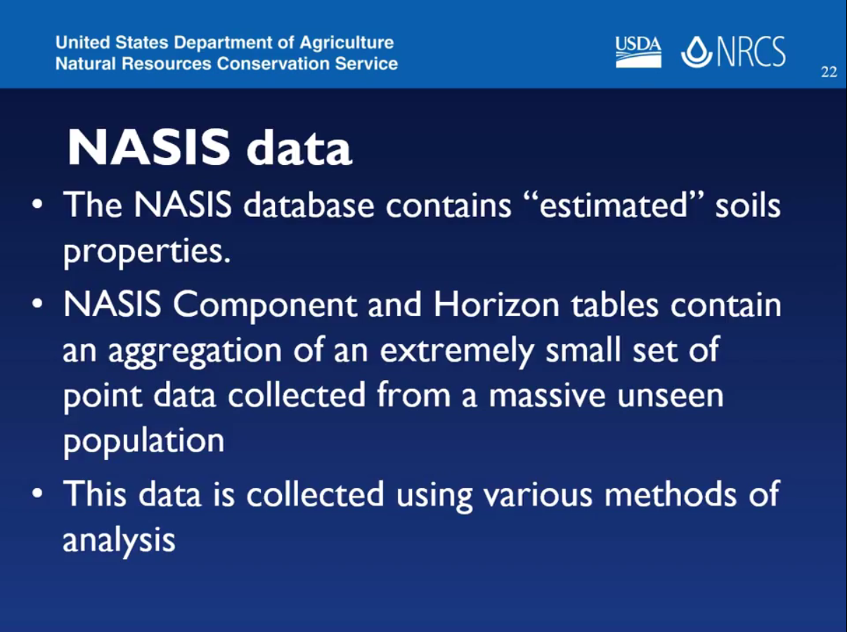
Pre-course Assignment: History of NASIS
Notes:
In Paul’s Youtube lecture, he discussed the difference between estimated and analyzed soil properties and presented an example of the importance of site selection. We as soil scientists have to extrapolate knowledge gained from a small set of point data to very large, unseen areas.

Slide 9
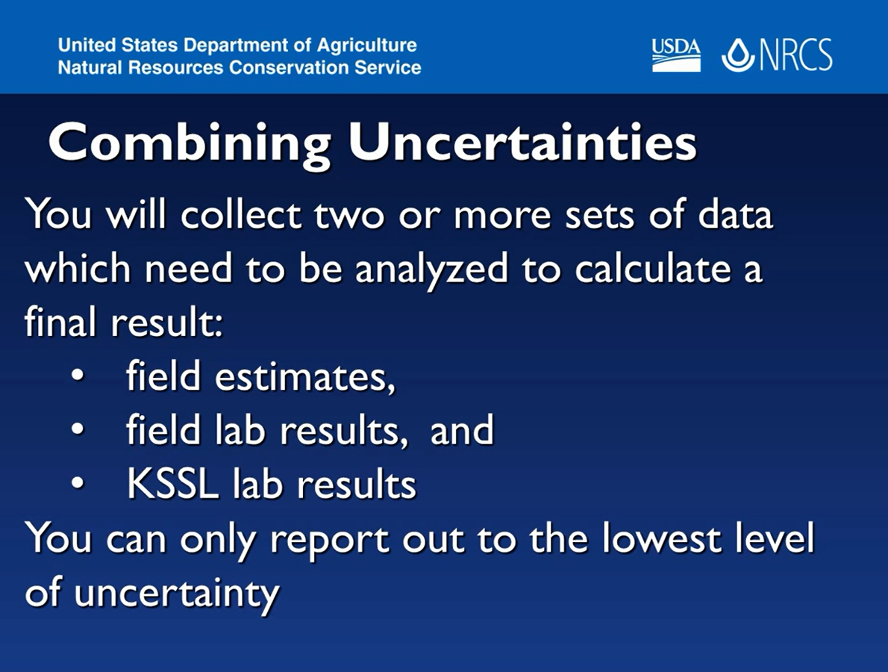
Pre-course Assignment: History of NASIS
Notes:
You should only populate NASIS with the lowest level of uncertainty..which is your field estimates. Do not populate NASIS with decimal points (lab precision/accuracy).

Slide 10
Pre-course Assignment: RStudio
In the pre-course assignment, we had you:
Set your working directory and verify RStudio version
Install packages
Establish an open database connection (ODBC) to NASIS

Slide 11
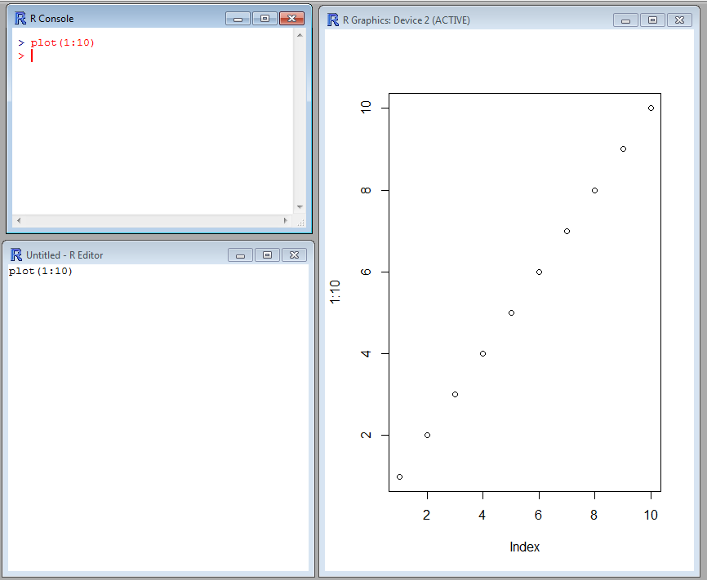
Introduction to R
R Console:
R code is typed here when it is ready to be executed.
R Graphics:
Graphics are displayed in this window after plot() or another graphics function is executed in R Console.
R Editor:
R code is typed here when it is in the process of being edited (you can also use notepad, notepad ++, etc.).
Notes:
Who has experience using R?
For those who have used R, what do you use it for? (have students type in chat)
There are two R programs can be found using the start>all programs menu at the bottom left hand portion of your screen: R and Rstudio. Both programs are command line driven that allow graphical display.
There are three main windows in R that you can use to conduct your data analysis: R Console, R Editor, and R Graphics. The R Editor window is simply a text editing window, you may also use notepad or notepad ++. The R Graphics window will only display when a command such as plot ( ) is executed.

Slide 12
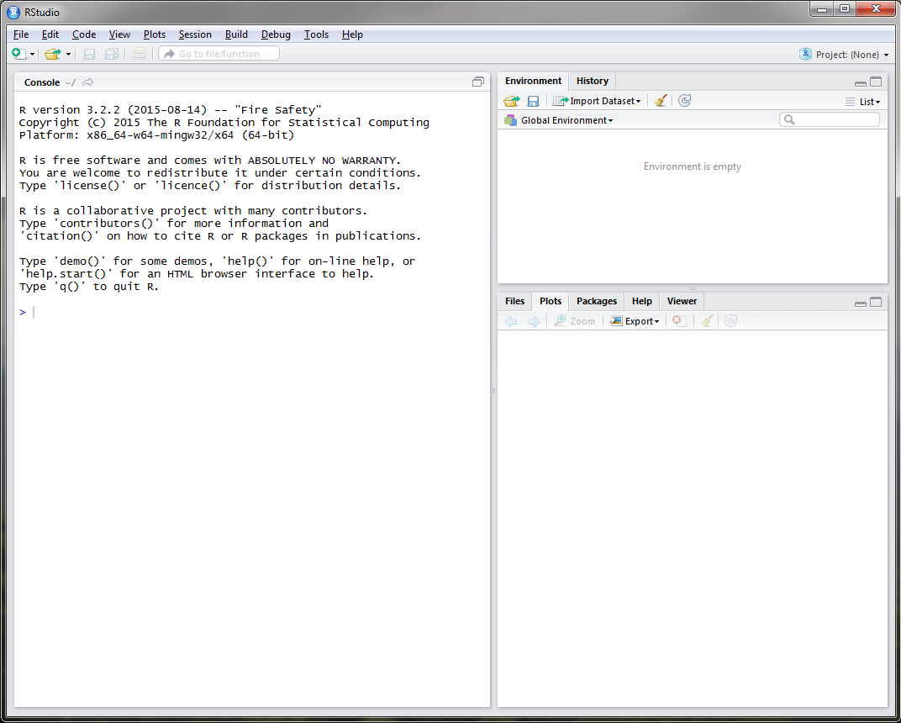
RStudio
Notes:
R studio is similar to R GUI, but is more user friendly. When you open Rstudio on your machine, you will see 3 windows: the console window, just like in the R GUI and two other windows composed of multiple tabs. The upper right window has two tabs: environment and history. The environment tab will keep track of the datasets that you import and objects that you create.

Slide 13
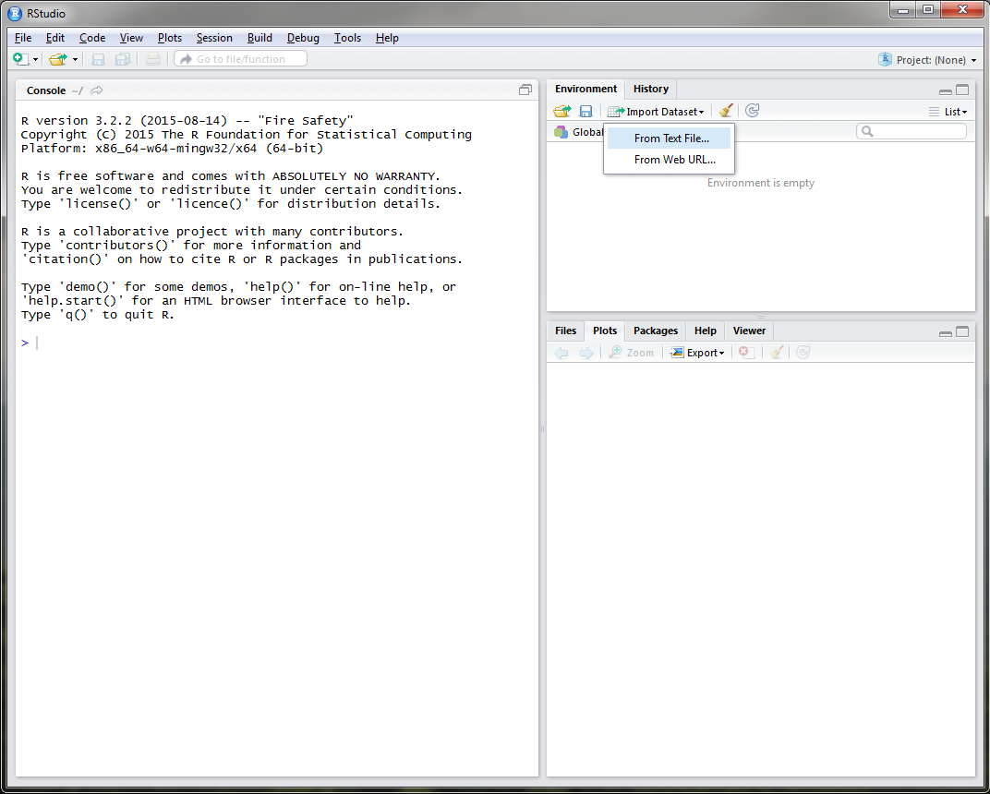
RStudio
Notes:
You can also import a dataset using the Environment Tab.

Slide 14
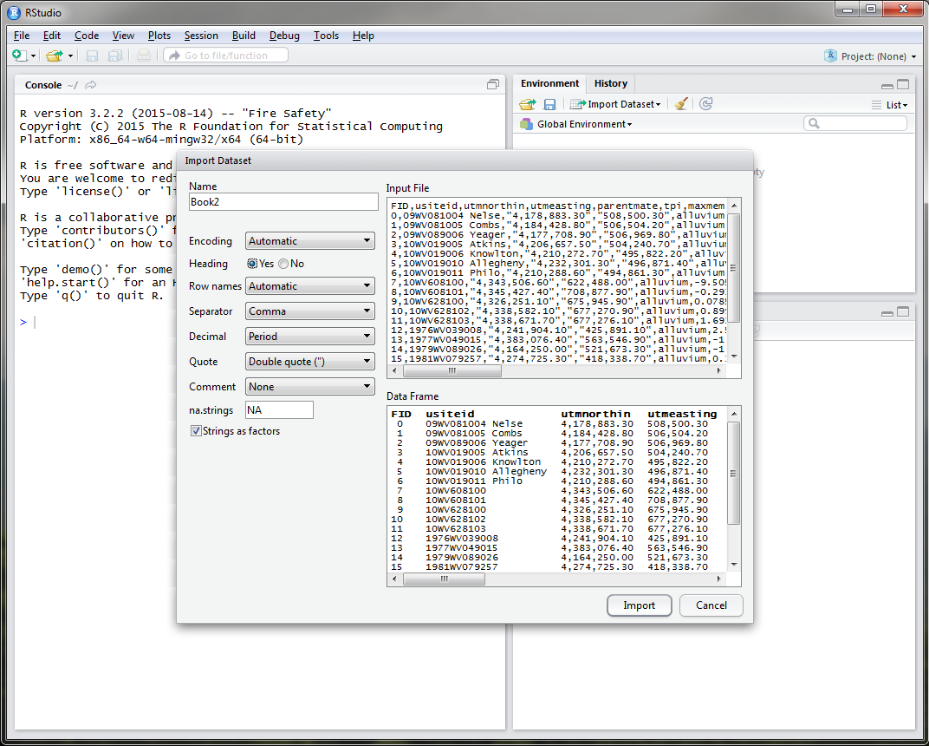
RStudio

Slide 15
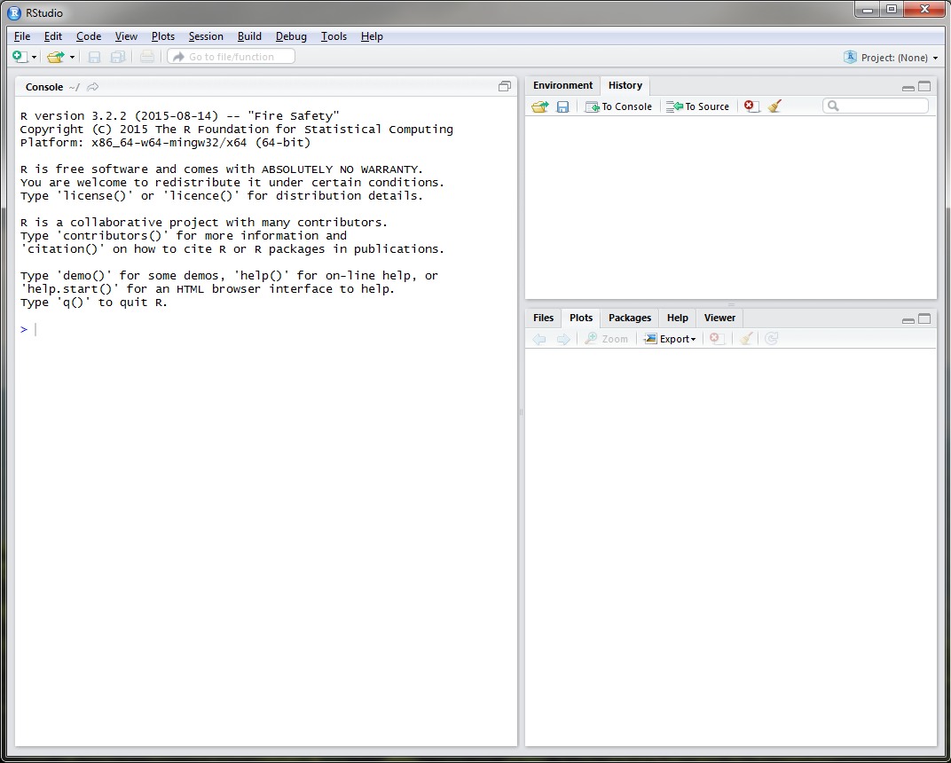
RStudio
Notes:
The History tab will display a history of all of the commands you’ve executed during your Rstudio session.
The bottom right window is composed of 5 tabs which I will go into a little bit later in the presentation.

Slide 16
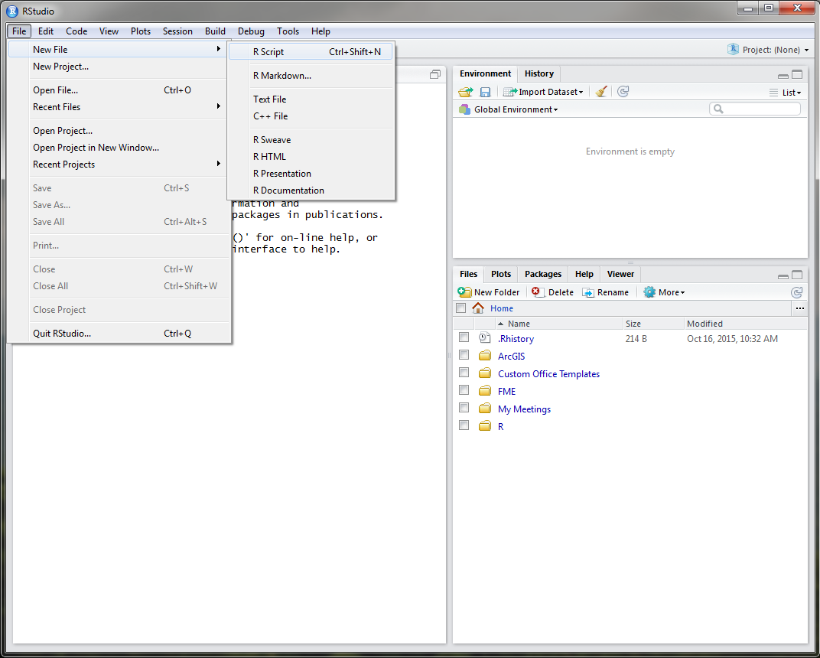
RStudio
Notes:
The text editor window in Rstudio can be opened using the File drop down menu.

Slide 17
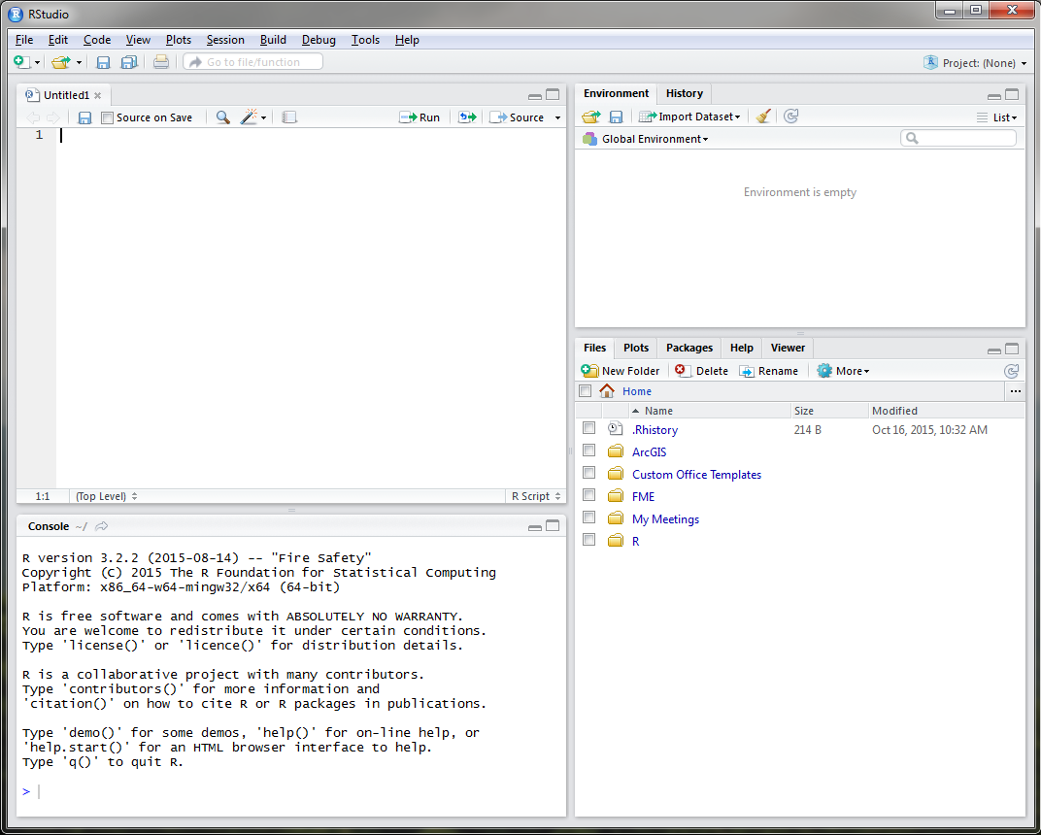
RStudio
Notes:
It is recommended to use the text editor window to develop your code before executing it in the console window.

Slide 18
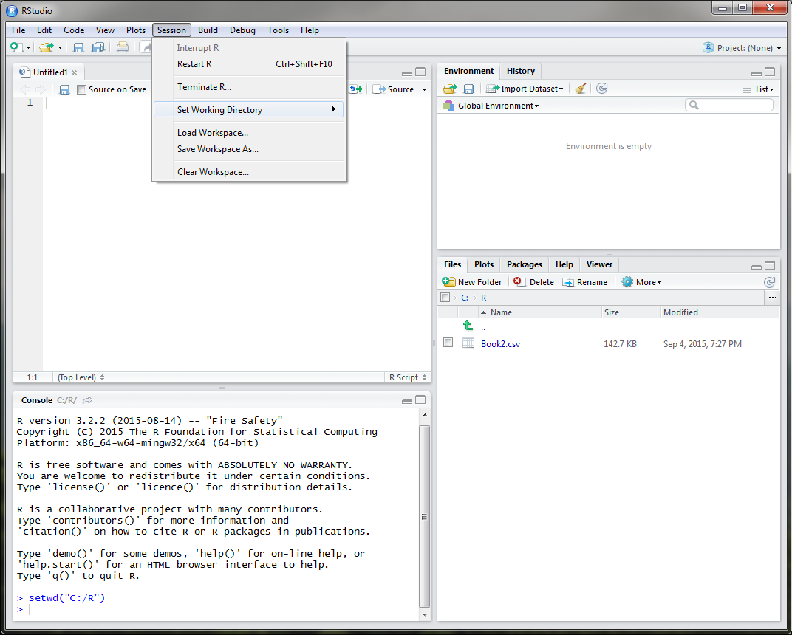
RStudio
Notes:
At the beginning of each R session, whether you are using R or Rstudio, you want to make sure that you set your working directory. This directory should be where your input datasets are stored, R files are located, and will also serve as the default storage of plots or exported objects from R. To do this in Rstudio, simply use the Session drop down menu. Notice that once you set your working directory, the Files tab in the bottom right window navigates to the directory that you specified, in this example, a folder called R on the C drive.

Slide 19
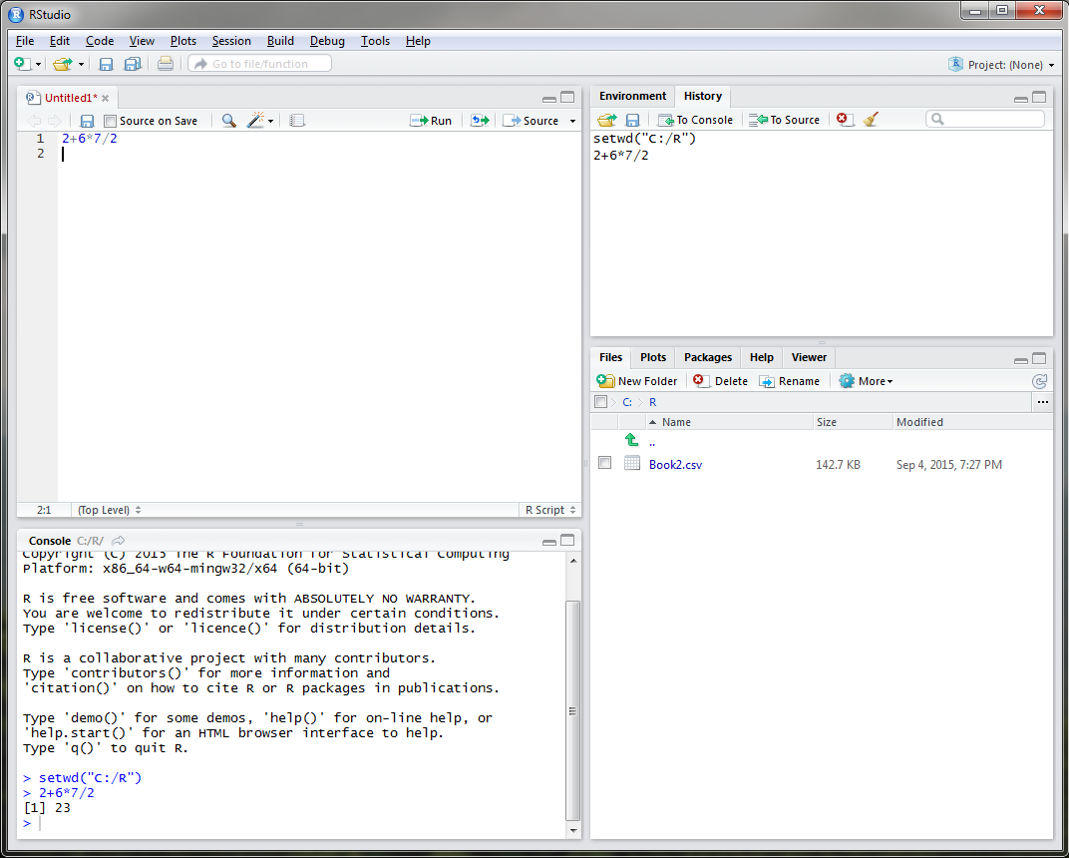
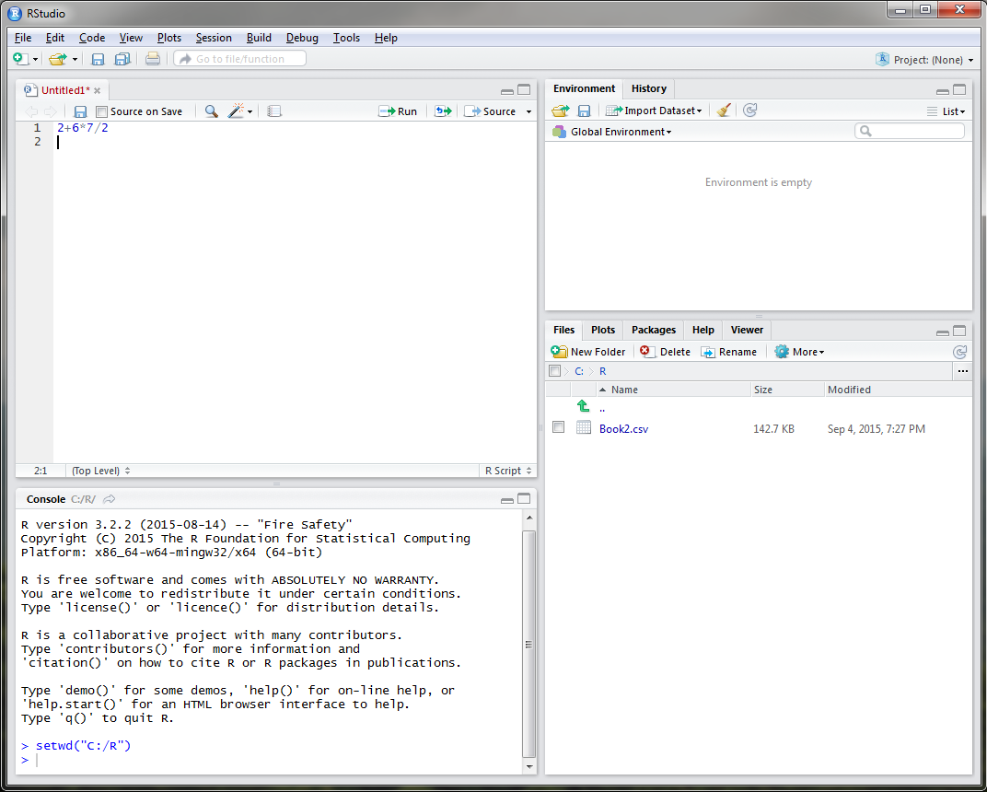
RStudio
Notes:
R can be used as a calculator to solve simplistic mathematical equations like the one currently displayed, as a GIS, for statistical analysis, for sampling design, and for modeling. In order to execute the equation that I have typed, I must place my cursor on line 1 or highlight line 1 and select the Run button.
-Click-
Notice that the answer to my equation is displayed in the console window in the bottom left and the command is added to the History tab.

Slide 20
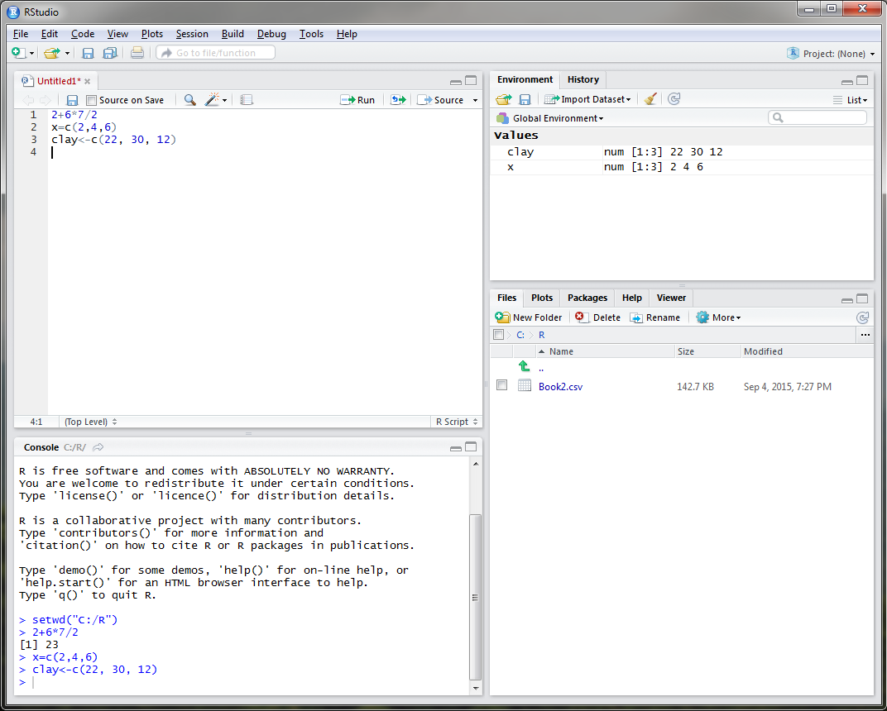
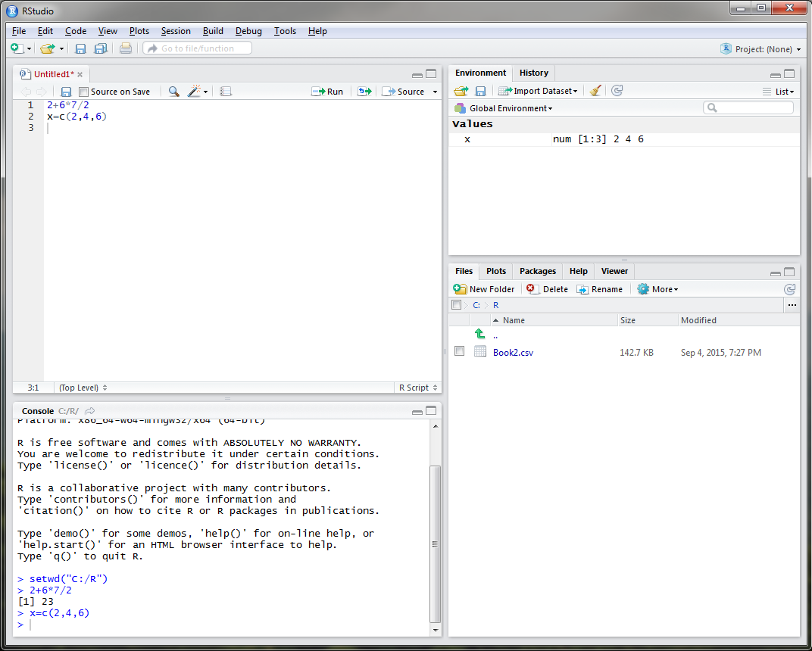
Rstudio - Objects
object <- function
object = function
Notes:
In R you can assign almost anything as an object, including a single number or letter, model, settings, or dataset. For example, say I wanted to create an object entitled x that displayed rock fragment content of 3 different sites. I could do this in R by typing, x equals the concatenate function that links together the rock fragment values of 2, 4, and 6. Objects are displayed in the Environment tab in the upper right corner. In order to create an object in R, you must use either the = sign or a less than with a dash, either is fine. It is personal preference.
-Click-
Let’s create an object called clay to represent the clay content at these three sites.

Slide 21
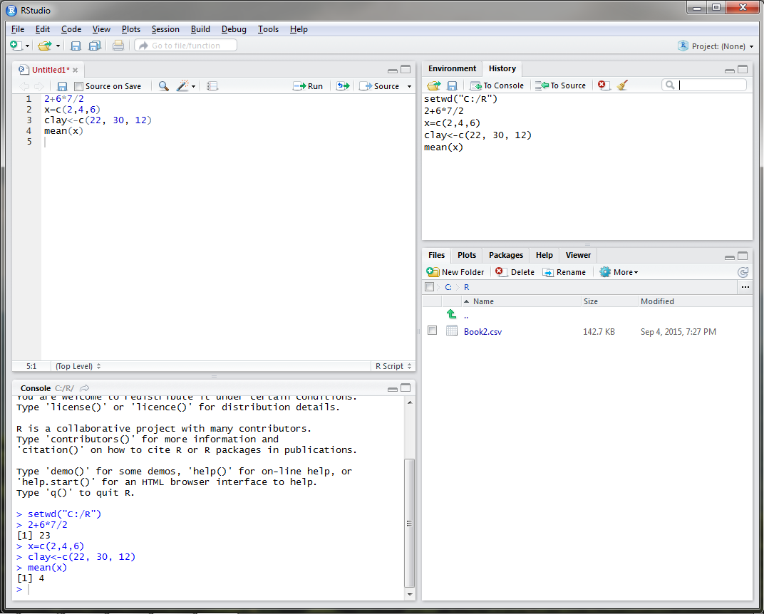
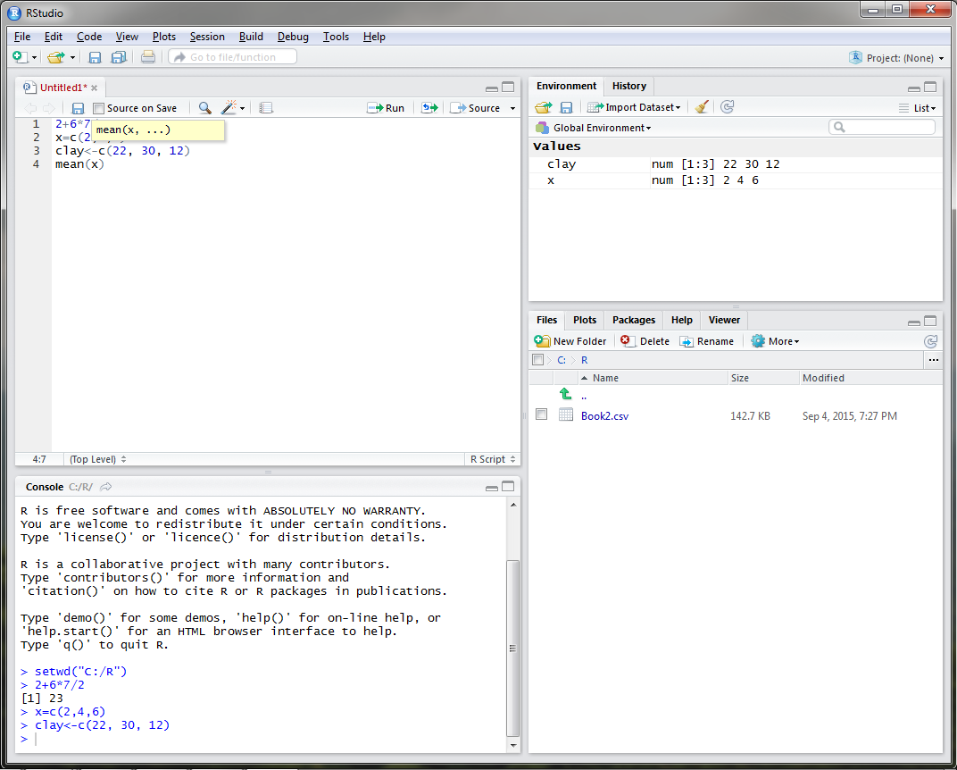
RStudio
Notes:
Say we wanted to know the mean of our rock fragment content. The function for mean is conveniently mean in R, so you would type mean with x (our rock fragment dataset) in parenthesis.
-Click-
Once you run this command, the answer is displayed in the console as 4 and the function is added to the R history tab. When you type a function in Rstudio, a drop down menu will open that will list all available functions with the term that you type.

Slide 22
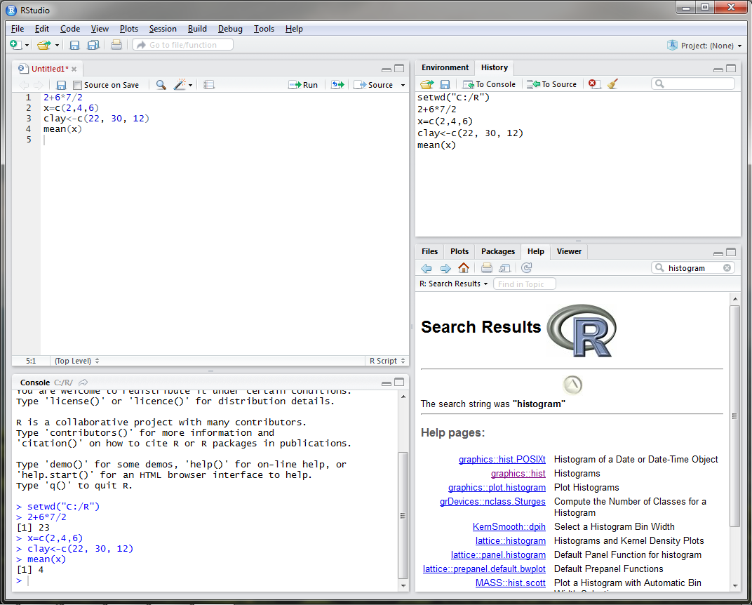
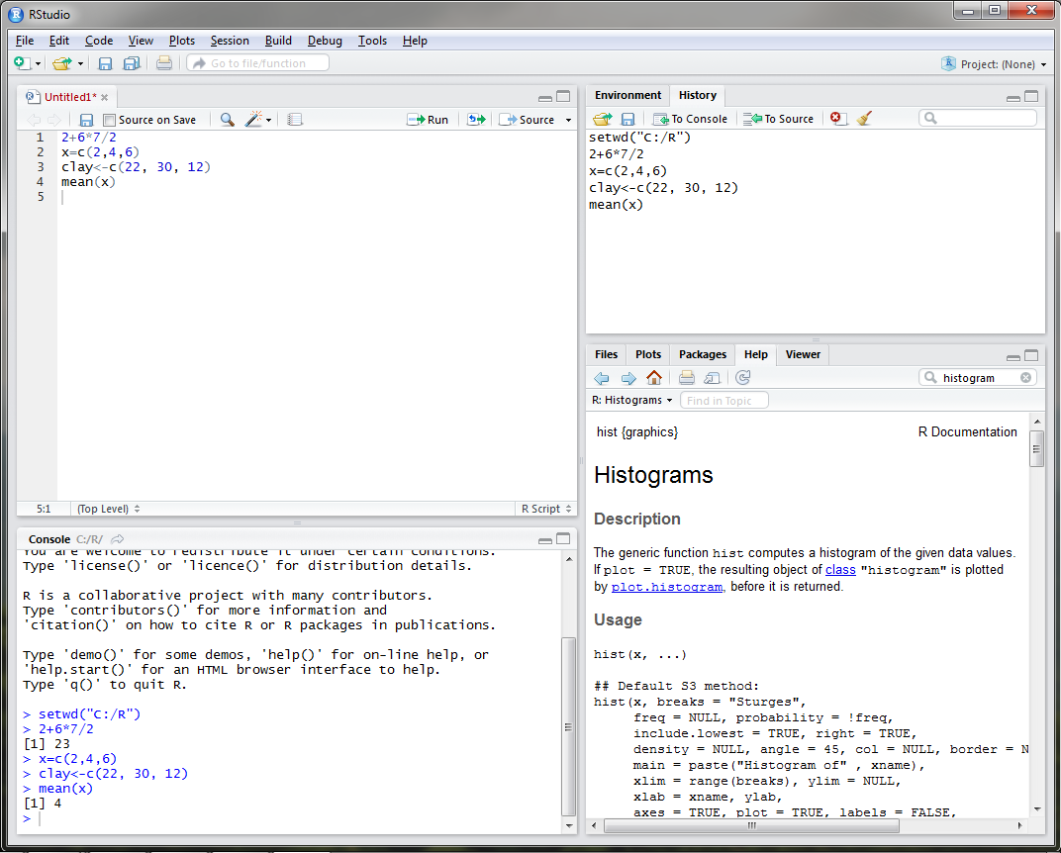
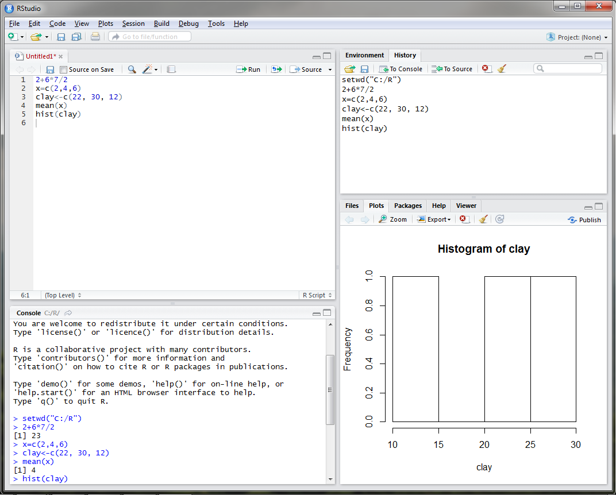
RStudio
Notes:
What if I wanted to view the distribution of clay content? What function would I use? If I was unsure, I could use the Help tab in the bottom right and search for histogram.
-Click-
If I click on the graphics: hist link, a webpage describing the hist function appears.
-Click-
If I execute the hist command for clay content, you can see that a plot is generated in the plot tab in the bottom right.

Slide 23
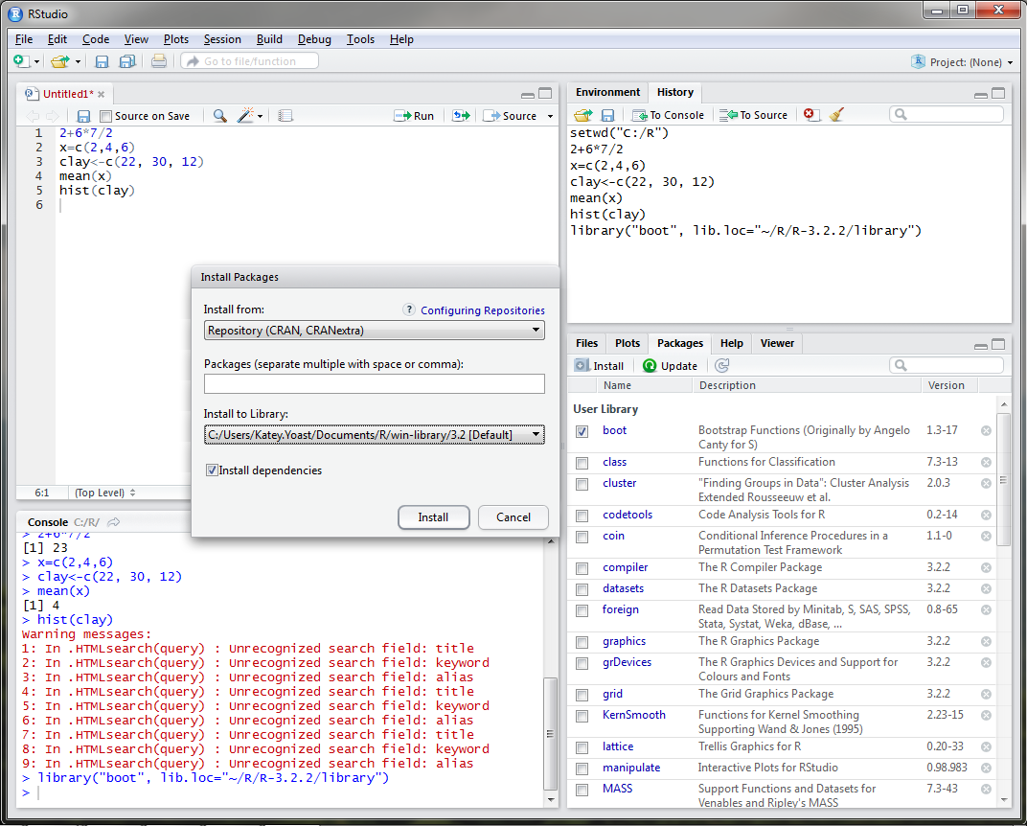
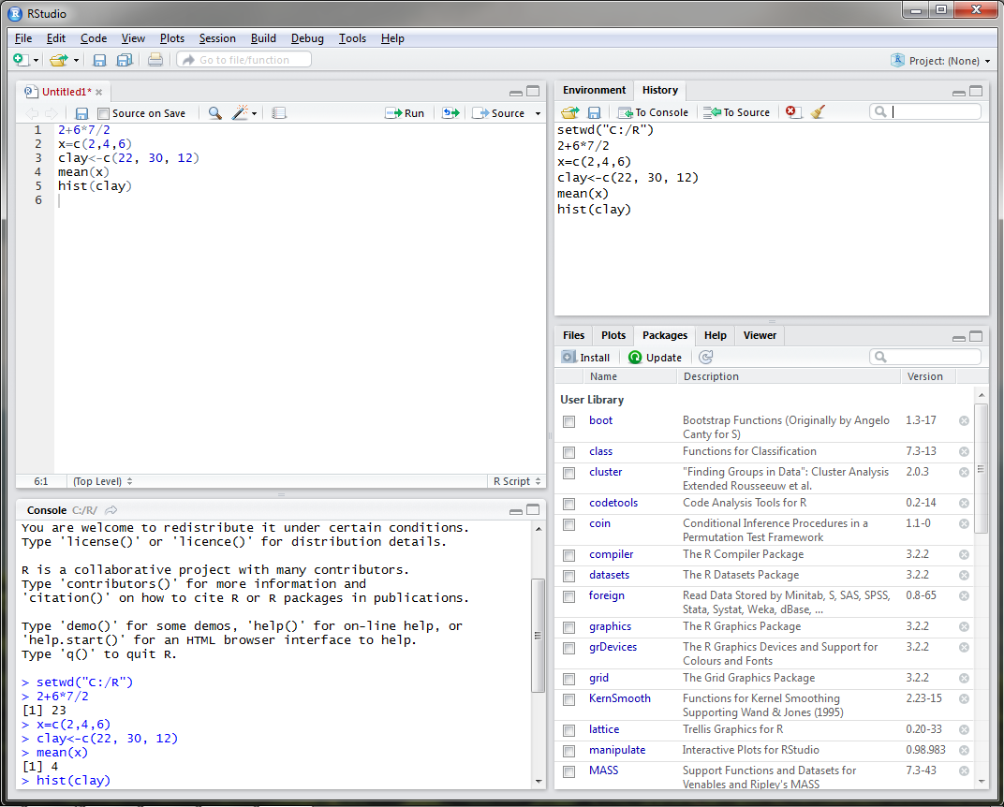
Rstudio – Installing Packages
Notes:
One thing that I have yet to mention is that both R programs are equipped with base packages that contain functions such as hist and mean. Packages are simply collections of code developed by R users. There are currently over 7,300 packages developed for use in R. For user convenience, Rstudio developed a Packages tab in the lower right window of the most commonly used packages. In order to utilize these packages, the user must select the check box next to the desired package and select install. –Click-

Slide 24
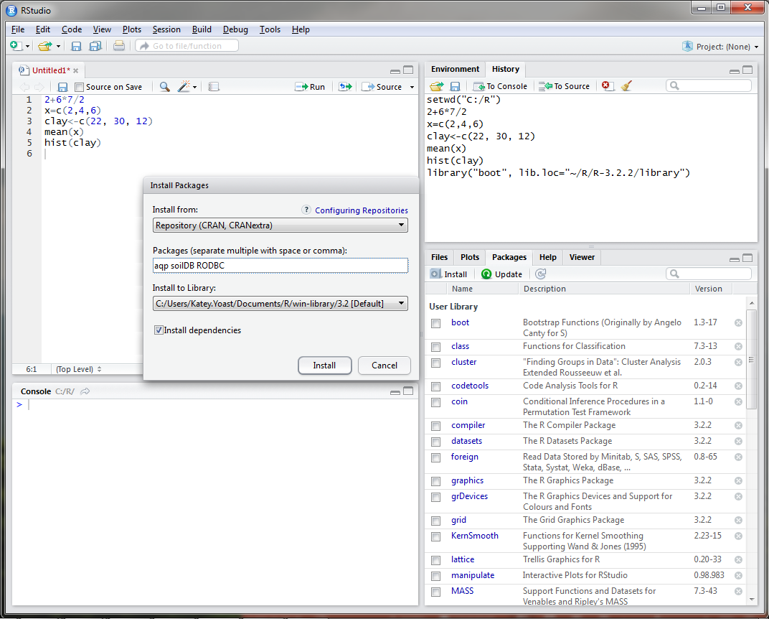
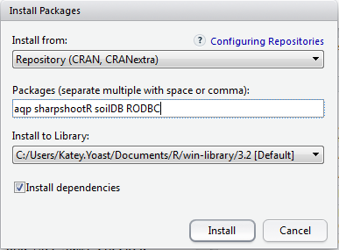
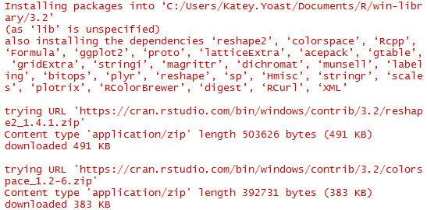
Rstudio – Installing Packages
Notes:
It may be necessary to install several packages that are not listed under the Packages tab. With no packages selected, click on Install under the Packages tab. In the packages text line, we will type four packages that have been used for soil survey applications, the aqp, sharpshootR, soilDB, and RODBC packages. Packages only need to be installed the first time you use them on your machine.
-Click-
Notice that the packages that we have installed depend and utilize many other packages that were also installed on our machine. It is important to always check the install dependencies box when installing a package in R.
AQP – visualization, aggregation, classification
soilDB – access to commonly used soil databases
SharpshootR – misc. soil survey specific functions
RODBC - ODBC Database Access

Slide 25
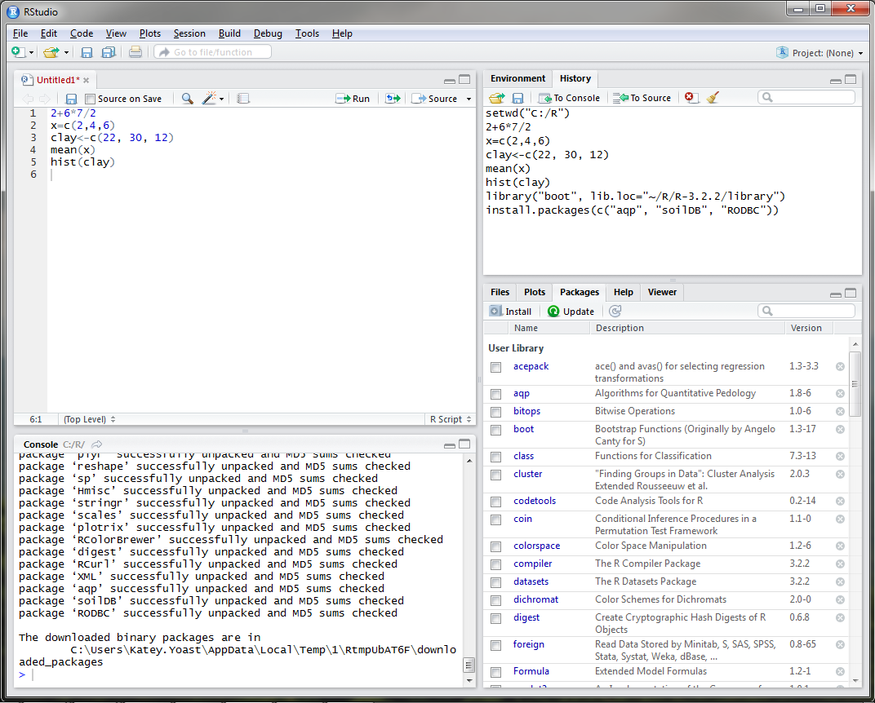
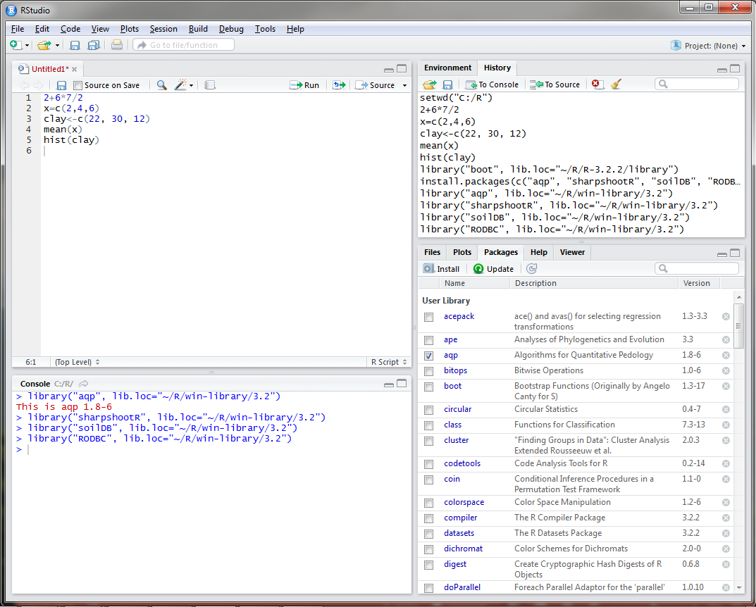
Rstudio – Installing Packages
Notes:
Once installed, the packages are added to the Package tab in the bottom right corner. You can update packages when necessary by selecting the check box next to the package name and clicking on the update button. Updates are available fairly often depending on the package, so it is important to keep packages updated. Every time you open Rstudio, you will need to load the packages that you are going to use during your R session by checking the box next to the package name.
All packages in R are required to meet certain standards set by The Comprehensive R Archive Network, including documentation, sample datasets, and examples. Once you find a package that will accommodate the functions that you wish to run, it is simply a matter of reading the documentation and viewing the examples to understand how to apply the function to your data. Since R is an open source program, there are a TON of resources available online.

Slide 26
Pre-course Assignment: Open Database Connection (ODBC) to NASIS
Links a local NASIS database to R so that pedon and DMU records can be queried with the soilDB package in RStudio.
Only needs to be done once on your machine.
Suggested NASIS queries to run:
Pangaea query POINT - Pedon/Site/Transect by Current Taxon Name. This accepts a Taxon Name, for example, Gauley.
Pangea query POINT - Pedon/Site by Correlated Name.
Pangea query POINT - Pedon/Site/Transects by User Pedon ID (2100 Max). This accepts a comma delimited list, for example, 95IL151005E, 94IL153001, 95IL153001, 92IL163017.
Pangea query POINT - Pedon/Site/Transects by Pedon Rec ID (2100 Max). This accepts a comma delimited list, for example, 44249, 175077, 101806, 44411.
Pangea query POINT - PedonHorizon/Site/Transect by HorizonRecID (2100 Max). This accepts a comma delimited list, for example, 210618, 210619, 853291, 208951.
Notes:
In order to fetch data from NASIS, data must first be in your selected set. The NASIS queries displayed above are suggested by Tom and Stephen for loading data into your selected set.

